Slide 1
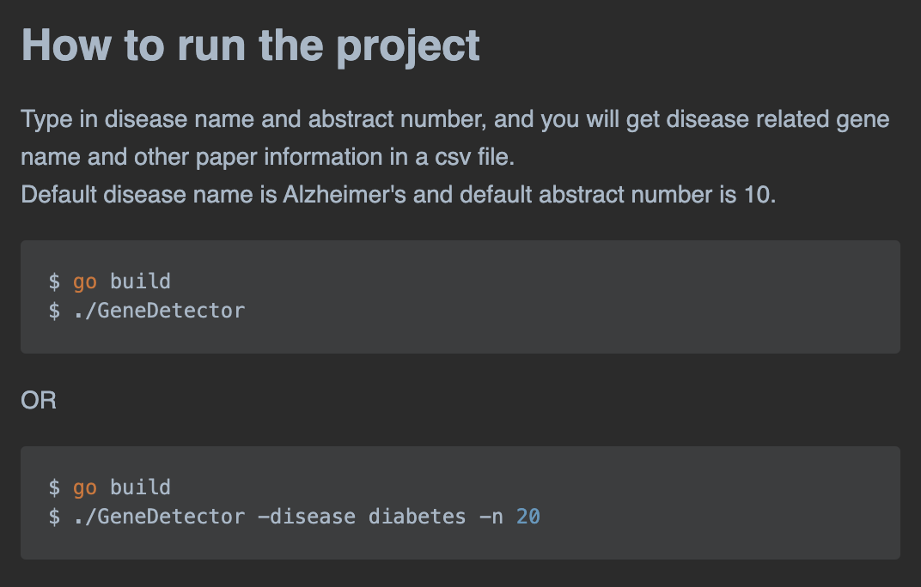
First Search Page
Set target URL
Create client
Set header
Get/Post request
Receive response
Get CsrfToken + Total Search Page
Get cookies
Download data
Strategy:
Use Regular Expression to match the gene name
GeneDetector
Get the gene name that related to your interested disease from PubMed Abstract.
Parse data
Write into CSV
CsrfToken
Cookies
Following Search Page
Set target URL
Create client
Set header
Get/Post request
Receive Response
Download data
CSV file header includes:
Paper title, url, abstract content, gene name, pmid, doi, keyword(disease name)
WEB SCRAPING STEPS
Request-Response
Parse and Extract
Download Data

